Slide 1

Mobile Application Development
Welcome
Class: BS(CS)-VII
Sukkur IBA University – Kandhkot Campus
Week - 03
Lecture – 05 & 06
Your Facilitator, Adil Khan

Slide 2
Activity State

Slide 3
When does config change?
Configuration changes invalidate the current layout or other resources in your activity when the user:
Rotates the device
Chooses different system language, so locale changes
Enters multi-window mode (from Android 7)

Slide 4
What happens on config change?
On configuration change, Android:
1. Shuts down Activity by calling:
onPause()
onStop()
onDestroy()
2. Starts Activity over again by calling:
onCreate()
onStart()
onResume()

Slide 5
Activity instance state
State information is created while the Activity is running, such as a counter, user text, animation progression
State is lost when device is rotated, language changes, back-button is pressed, or the system clears memory

Slide 6
Saving the Activity instance state
Implement onSaveInstanceState() in your Activity
Called by Android runtime when there is a possibility the Activity may be destroyed
Saves data only for this instance of the Activity during current session

Slide 7
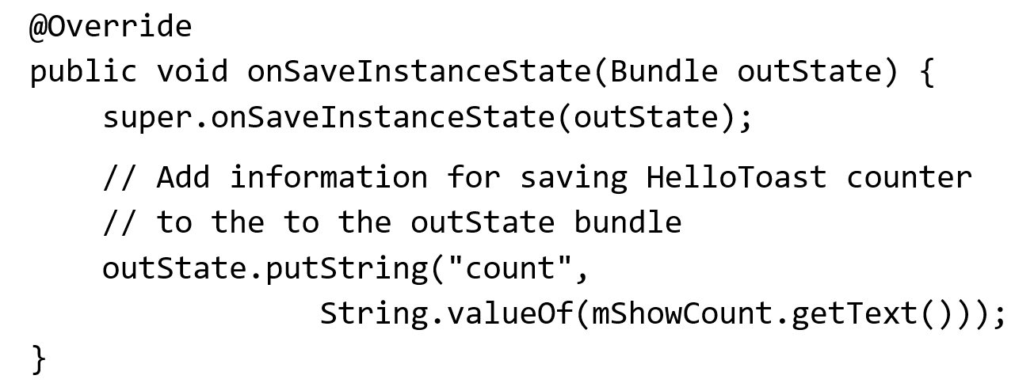
Saving the Activity instance state

Slide 8
Restoring instance state
Two ways to retrieve the saved Bundle
in onCreate(Bundle mySavedState) Preferred, to ensure that your user interface, including any saved state, is back up and running as quickly as possible
Implement callback (called after onStart()) onRestoreInstanceState(Bundle mySavedState)

Slide 9
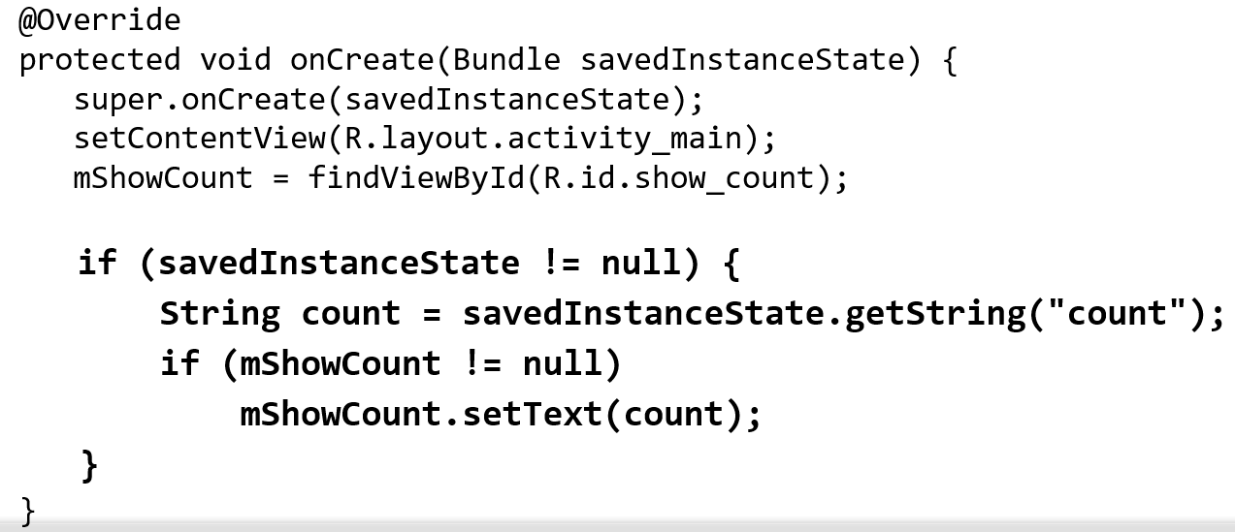
Restoring in onCreate()

Slide 10
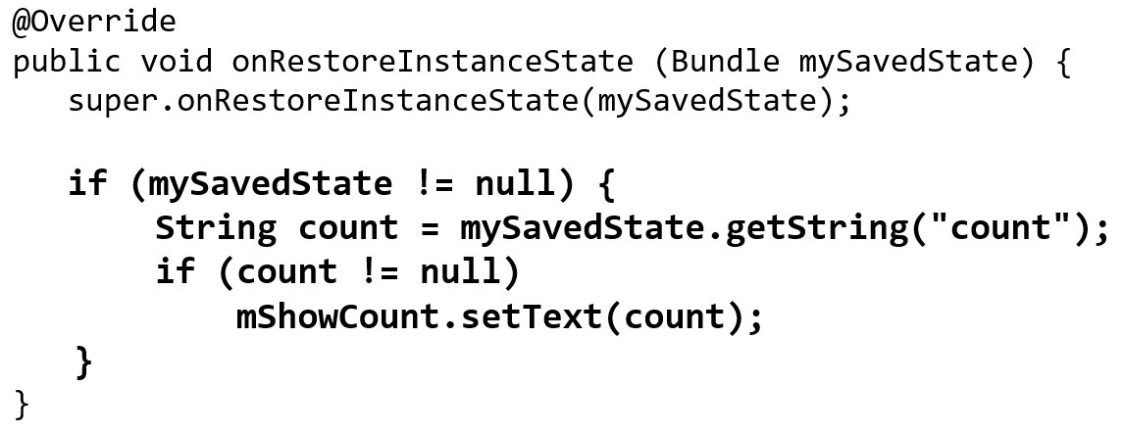
onRestoreInstanceState(Bundle state)

Slide 11
Instance state and app restart
When you stop and restart a new app session, the Activity instance states are lost and your activities will revert to their default appearance
If you need to save user data between app sessions, use shared preferences or a database.

Slide 12
Thank you!
Any Questions???

